Slide 1

Kinetic Modelling of Fast Catalytic Pyrolysis of biomass
Name: Abhijeet P. Selukar [CA21M001]
Guide: Prof. Himanshu Goyal
Department of Chemical Engineering , IIT Madras

Slide 2

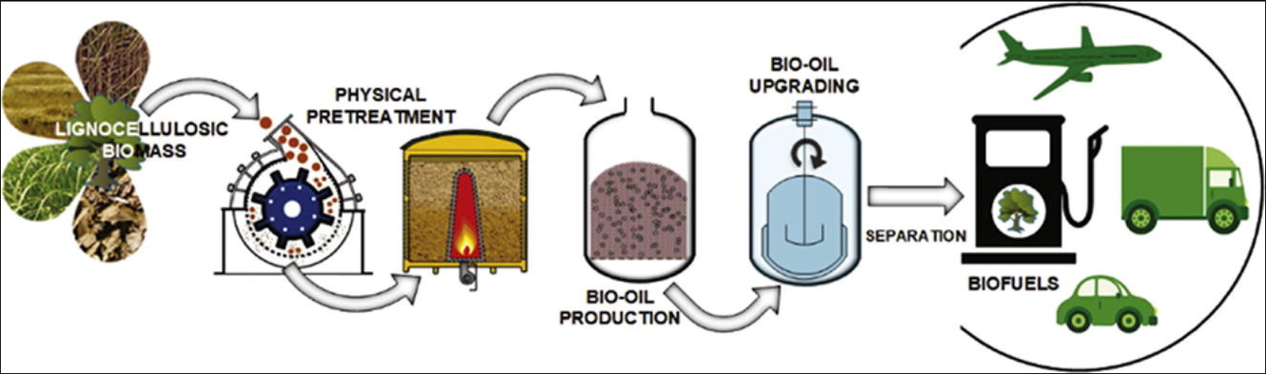

Slide 3
Fast Pyrolysis
Fast pyrolysis is a technique for thermally breaking down different biomass types in the absence of air or oxygen to produce products based on their nature, such as solid char, liquid oil, and volatile gas.
Fast Catalytic Pyrolysis
Ex-situ : A catalyst is directly combined with the feedstock of a Pyrolysis Reactor.
FCP is an attractive technology that integrates fast pyrolysis of biomass and catalytic upgrading into a single process to produce bio-oil with enhanced quality that could potentially fit into existing infrastructure.
In-situ : The catalyst is directly connected with pyrolysis fumes, resulting in higher quality bio-oil

Slide 4
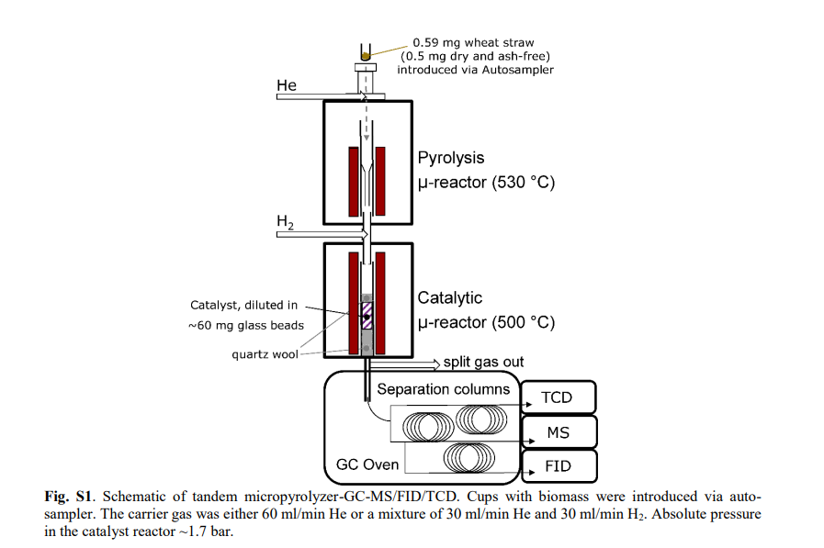
Fast pyrolysis conditions:
Pyrolysis Temperature= 500 °C
Heating rate is high (1000 °C/s)
Yield: Bio-oil~ 60-70 wt%
Bio-char~ 15-25 wt%
Syn gas ~ 10-15 wt%
Factors affecting pyrolysis process:
Temperature
Retention time
Feedstock composition
Type of catalyst used
Moisture content
Heating rate
Particle size
Pyrolysis Process
Ref: Advances in Chemical Engineering, Volume 49, Chapter 2 “Mechanistic understanding of thermochemical conversion of polymer and lignocellulosic biomass”

Slide 5
Kinetic Model
It explains experimental observations, Promotes an understanding of the kinetics of biomass pyrolysis, Simplifies data collection and analysis as well as the numerical implementation
Iso-thermal method
The iso-thermal method is utilized for kinetic analysis, in which we keep the temperature constant while varying the heating rate to investigate the behavior of kinetic parameters
Iso-conversional method
The iso-conversional method is also used in kinetic analysis to explore the behavior of kinetic parameters by keeping the conversion constant while altering the temperature and heating rate

Slide 6
Model-Free Iso-conversional Method:
Distributed Activation Energy Model (DAEM):
$$ln\frac{β}{T^{2}}=\ln\left(\frac{Rk_{0}}{E}\right)+0.6075−\frac{E}{RT}$$
𝐥𝐧 𝛃/𝐓^𝟐 =𝐥𝐧⁡((𝐑𝐤_𝟎)/𝐄)+𝟎.𝟔𝟎𝟕𝟓−𝐄/𝐑𝐓
Kissingers-Akhira-Sunose(KAS):
$$ln\frac{β}{T^{2}}=ln(\frac{Rk_{0}}{EG\left(α\right)})− \frac{E}{RT}$$
𝐥𝐧 𝛃/𝐓^𝟐 =𝐥𝐧((𝐑𝐤_𝟎)/𝐄𝐆(𝛂) )− 𝐄/𝐑𝐓
Flynn-Wall-Ozawa(FWO):
$$lnβ=ln\frac{0.0048AE}{RG\left(α\right)}−1.052\frac{E}{RT}$$
𝐥𝐧𝛃=𝐥𝐧 (𝟎.𝟎𝟎𝟒𝟖𝐀𝐄)/𝐑𝐆(𝛂) −𝟏.𝟎𝟓𝟐 𝐄/𝐑𝐓
Starink Method:
$$ln\frac{β}{T^{1.92}}= C_{s}−1.0008\frac{E}{RT}$$
𝐥𝐧 𝛃/𝐓^(𝟏.𝟗𝟐) = 𝐂_𝐬−𝟏.𝟎𝟎𝟎𝟖 𝐄/𝐑𝐓
Friedman Method:
ln($β\frac{dα}{dt})=\ln\left(k_{o}f\left(α\right)\right)−\frac{E_{a}}{RT}$
ln(𝛃 𝐝𝛂/𝐝𝐭)=𝐥𝐧⁡(𝐤_𝐨 𝐟(𝛂))−𝐄_𝐚/𝐑𝐓
β = Heating Rate

Slide 7



Distributed Activation Energy Model (DAEM) Equation:
$$ln\frac{β}{T^{2}}=\ln\left(\frac{Rk_{0}}{E}\right)+0.6075−\frac{E}{RT}$$
$$ln(β/T^{2})$$
Y =
C +
mX
1/T
m = $−\frac{E}{R}$
By using this formula we can find out Activation Energy and Pre-Exponential Factor
I used data from the Research paper Kinetics of Biomass Pyrolysis Using Nickel-Based Functional Materials .In which, they used three types of biomass, straw, sawdust, and cellulose. under three conditions: without catalyst, with Ni-CaO-Si₂O₄ catalyst and with Ni-Ca₂SiO₄ catalyst.

Slide 8
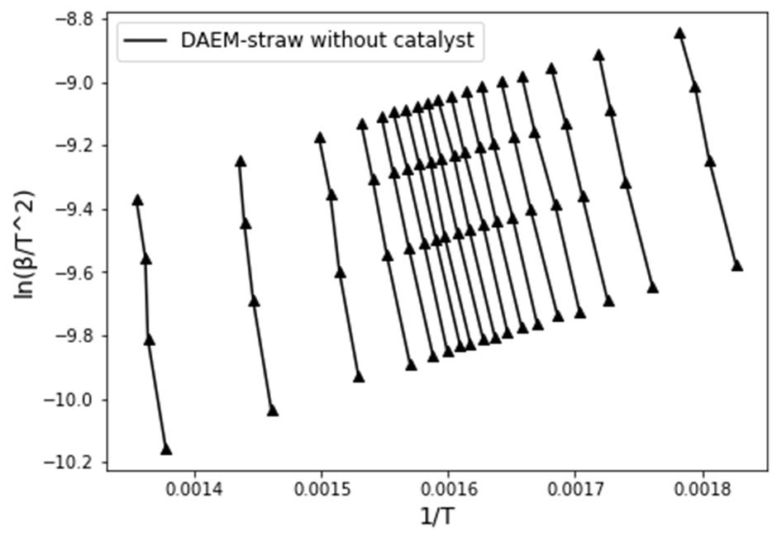

Distributed Activation Energy Model
50ºc/min
40ºC/min
30ºC/min
$$ln⁡(β/T^{2})$$
20ºC/min
0.05
α
0.9
1/T

Slide 9
The graph below depicts how activation energy varies :

Slide 10
The graph below depicts how Pre-exponential Factor varies :

Slide 11
Types of model
Nucleation-based model(P)
Geometrical contraction-based model(A,F)
Diffusion model(D)
Order-based model (R)
Master plot: It is a graphical method used to study the kinetic behavior of a substance, by plotting the variation of some characteristic quantity.

Slide 12
Master plot for Straw with three Conditions:
….…: Without Catalyst ….… : With Ni-CaOSi₂O₄ Catalyst ….…: With Ni-Ca₂SiO₄ Catalyst

Slide 13
Master plot for Sawdust with three Conditions:
….…: Without Catalyst ….… : With Ni-CaOSi₂O₄ Catalyst ….…: With Ni-Ca₂SiO₄ Catalyst

Slide 14
Master plot for Cellulose with three Conditions:
….…: Without Catalyst ….… : With Ni-CaOSi₂O₄ Catalyst ….…: With Ni-Ca₂SiO₄ Catalyst

Slide 15
Conclusion
The functional materials, Ni-CaOCa₂SiO₄ and Ni-Ca₂SiO₄, showed an obvious catalytic effect for the three types of biomass samples tested
The correlation R² of all fitting lines in all cases was above 0.9, which indicated that FWO method, KAS method, Friedman method and DAEM were suitable for modelling the kinetics of biomass catalytic pyrolysis whereas FWO method, KAS method, DAEM showed more accuracy as compare Friedman method.
For the three types of biomasses tested, the functional material, NiCaOCa₂SiO₄, showed the greatest catalytic effect on pyrolysis due to the evident decrease in activation energy. For sawdust, the functional material, Ni-Ca₂SiO₄ Catalyst showed Greater catalytic effect as compared to , NiCaOCa₂SiO₄ Catalyst
significant impact of catalysts on the reaction mechanisms. The use of NiCaOSi₂O₄ catalyst altered the reaction pathway, with involvement of nucleation, diffusion control, and multiple reaction mechanisms. The presence of catalysts provided better control over the conversion process and facilitated the production of targeted biofuels..

Slide 16

Reference
Liu, C., Wang, H., Karim, A. M., Sun, J., & Wang, Y. (2014). Catalytic fast pyrolysis of lignocellulosic biomass. Chemical Society Reviews, 43(22), 7594-7623.
Yang, Hang, et al. "Kinetics of catalytic biomass pyrolysis using Ni-based functional materials." Fuel Processing Technology 195 (2019): 106145.
Performance-screening of metal-impregnated industrial HZSM-5/γ-Al₂O₃ extrudates for deoxygenation and hydrodeoxygenation of fast pyrolysis vapors - ScienceDirect
Thank You

